Slide 1

SPRING CREW
INTEREST MEETING
Tuesday, February 10, 2026
7:00 pm
rockridgecrew.com

Slide 2
Agenda
Rock Ridge Crew Overview
Mission
History of Rowing
Board Members, Coaches, and Captains
2026 Spring Crew Calendar
Cost of Spring Season
Volunteer Requirements
Questions and Answers

Slide 3
Overview
Rock Ridge Rowing, Inc. is the parent booster organization supporting Rock Ridge Crew. Rock Ridge Rowing, Inc. is a non-for-profit [501(c)(3)] organization.
  Rock Ridge Crew is the student scholastic rowing team of Rock Ridge High School in Loudoun County, Virginia, established in 2014.
  Upper Potomac Rowing is a sub-organization of Rock Ridge Rowing allowing for non-Rock Ridge High School students to participate in rowing during the off-season.
    The vision is to promote and develop amateur rowing as a sport at Rock Ridge High School and in Loudoun County.

Slide 4
Mission
Our mission is to inspire excellence through the art and discipline of rowing. We are dedicated to fostering a culture of teamwork, perseverance, and personal growth while achieving the highest levels of performance on and off the water.
  The overall mission for the team is to have a boat place 1st or 2nd at VASRA States and attend Stotesbury Regatta.
  The mission for the parents is to provide the logistic support to have the team place a boat and to have great memories of the season!

Slide 5
The History of Rowing
Rowing, referred to as crew, is a sport whose origins reach back to many ancient civilizations. The modern sport of rowing, as we know it today, began in the early 19th century in England. In 1828, the world's oldest rowing club, Leander Club, was founded in Henley-on-Thames.
In this water sport, individuals or teams propel a boat (a "shell") through the water using oars. Rowers sit facing backward in the boat and use oars to push against the water, propelling the boat forward.
It is a full-body workout with 60% legs, 20% back and 20% arms.

Slide 6
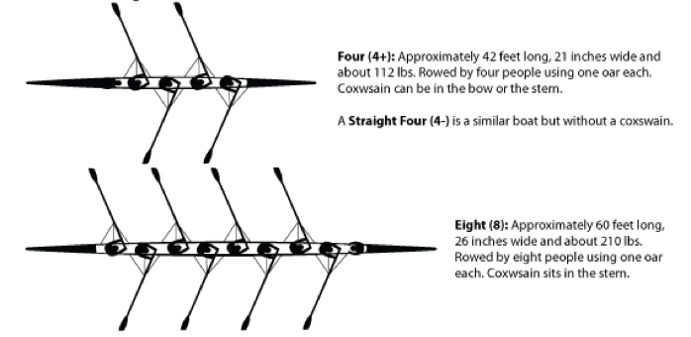
4+ and 8+ boats
Boats always require maintenance.
  New 4+ boats typically cost $17k+ shells, oars, and electronics.
  New 8+ boats typically cost $20k+.
  Safety Launches run $5k+.
  We primarily row 4+ and 8+ boats.
    4 oars person + coxswain.
    8 oars person + coxswain.

Slide 7
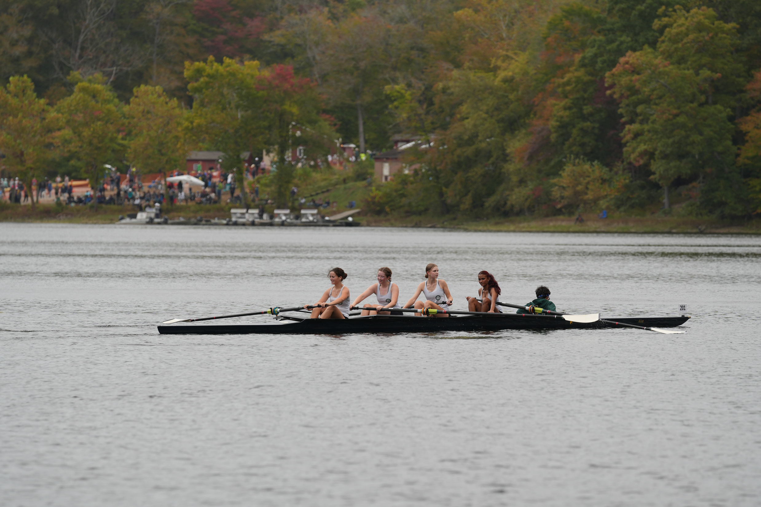

Slide 8
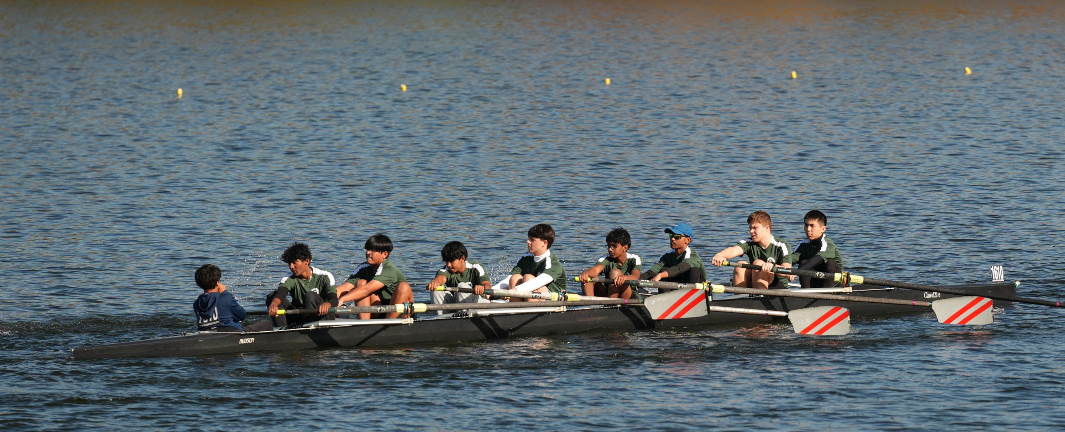

Slide 9
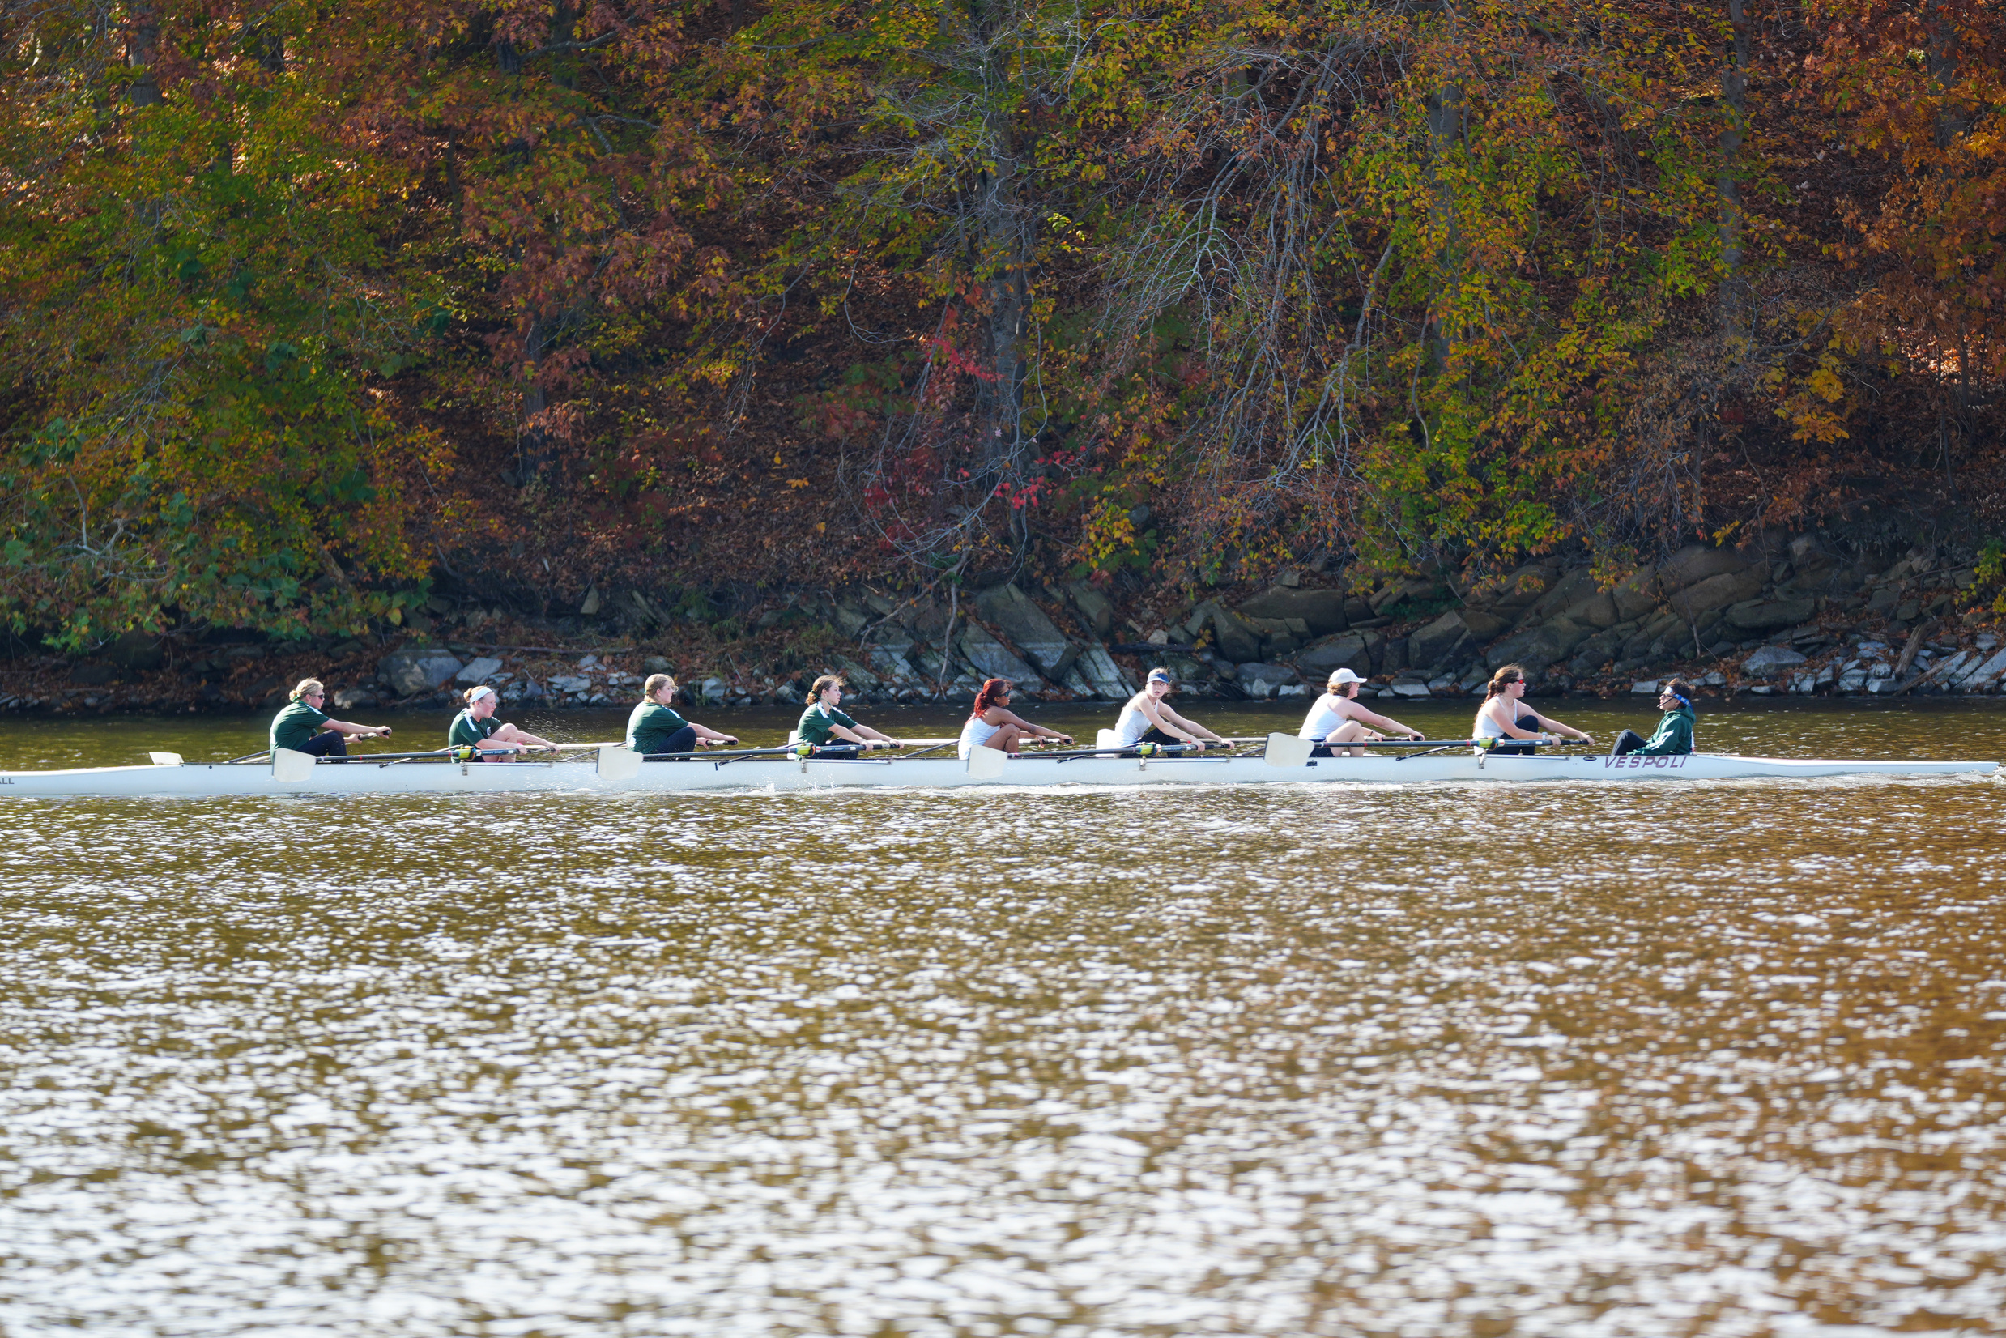

Slide 10
Board Members, Coaches, and Captains
President: John Seaton
Vice President: Gopi Desai
Treasurer: Saju Thomas
Communications: Nichole Gay
Head Coach Women: Coach Kat Louh
Head Coach Mens: Coach Shang Tan
Asst. Coach: Coach Jordan Robb
Asst. Coach: Coach Virginia Lewis
Co-Captain: August Gay
Co-Captain: Alex Saju

Slide 11
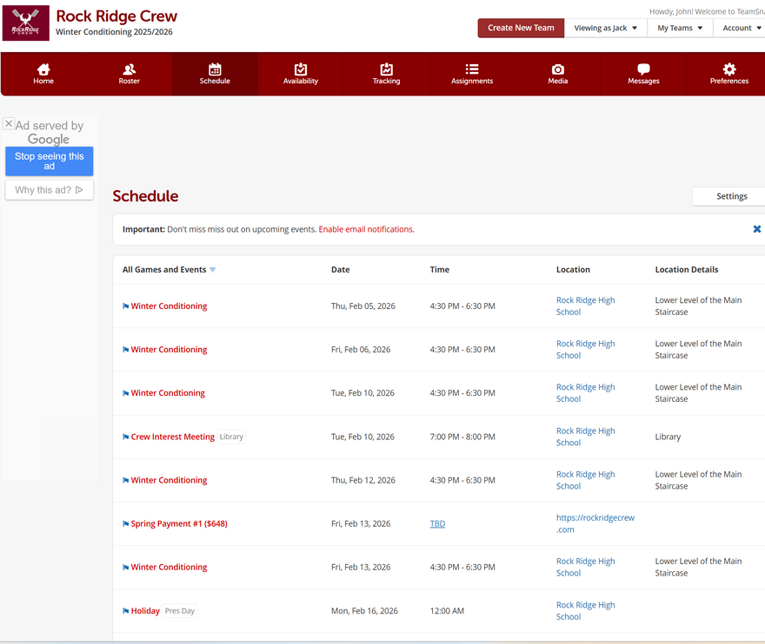
Crew Calendar 2026
February 13, 2026: Last day of Winter Conditioning (WC)
February 23, 2026: First day of Practice for the Spring Season
March 3, 2026: (tentative) Swim Test
March 6, 2026: Ergathon
March 21, 2026: Polar Bear Regatta (Experienced Rowers)
March 27, 2026: Team Dinner (CARB LOADING)
March 28, 2026: Walter Mess Regatta
April 18, 2026: RYZ Obuchowicz Regatta
April 25, 2026: Al Urquia Regatta
May 1, 2026: Team Dinner
May 2, 2026: States Day 1
May 9, 2026; States Day 2
May 15-16 2026: Stotesbury Regatta (Philadelphia)
Last Week of May: End of Season Banquet
**dates and times subject to change**

Slide 12
Cost of Spring Season
Crew is an expensive sport and does NOT receive any funding from the school system. We are a self-funded non-profit organization. Donations make up the difference between the dues and expenses per spring season. Fees and fundraising account for all costs such as, but are not limited to, safety equipment, racing shells, insurance, coaches' salaries, maintenance, and storage.
Fees do NOT include any food, lodging, and/or transportation at Stotesbury
Mandatory Items
  Spring Registration $250 due January 25, 2026 @11:59 pm.
  Spring Payment 1 $648 due February 13, 2026 @11:59 pm.
  Spring Payment 2 $649 due March 29, 2026 @ 11:59 pm.
  ERGathon Fundraising Commitment $400 due March 13, 2026 @11:59pm.
  Spiritwear (Mandatory Novice, select items only for Vets) est. $300 for novice due (TBD).
**dates, times, and prices subject to change**

Slide 13
Volunteer Requirements
Student Athletes are required to participation in 4 hours of non-consecutive volunteer hours. Some examples are, but not limited to re-rigging of equipment post regattas, ergathon, boathouse cleanup... Coaches will provide information as opportunities arise.
Family member(s) are required to collectively participate in a minimum of 6 hours of non-consecutive volunteer hours per Athlete. Some volunteer examples are, but not limited to, VASRA regatta HQ support, VASRA regatta boat driver, VASRA regatta land support, hospitality coordination, ergathon support...
Signup links on TeamSnap (under each Regatta date) will provide details on what parent help is needed. A description of volunteer positions can be found on the RockRidgecrew.com (under FAQs).

Slide 14
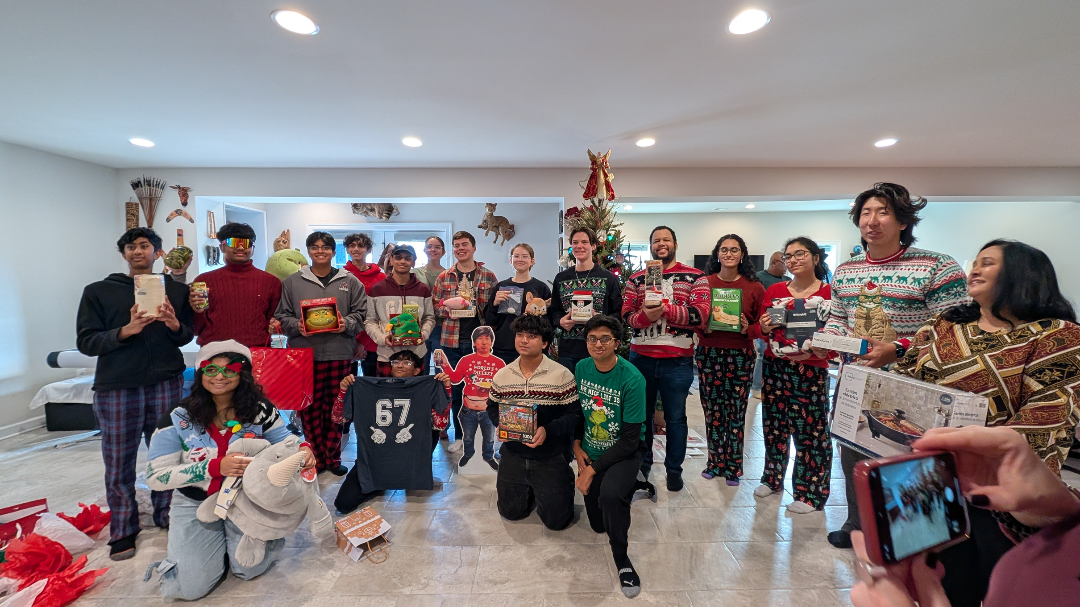
2025 White Elephant Christmas Party

Slide 15
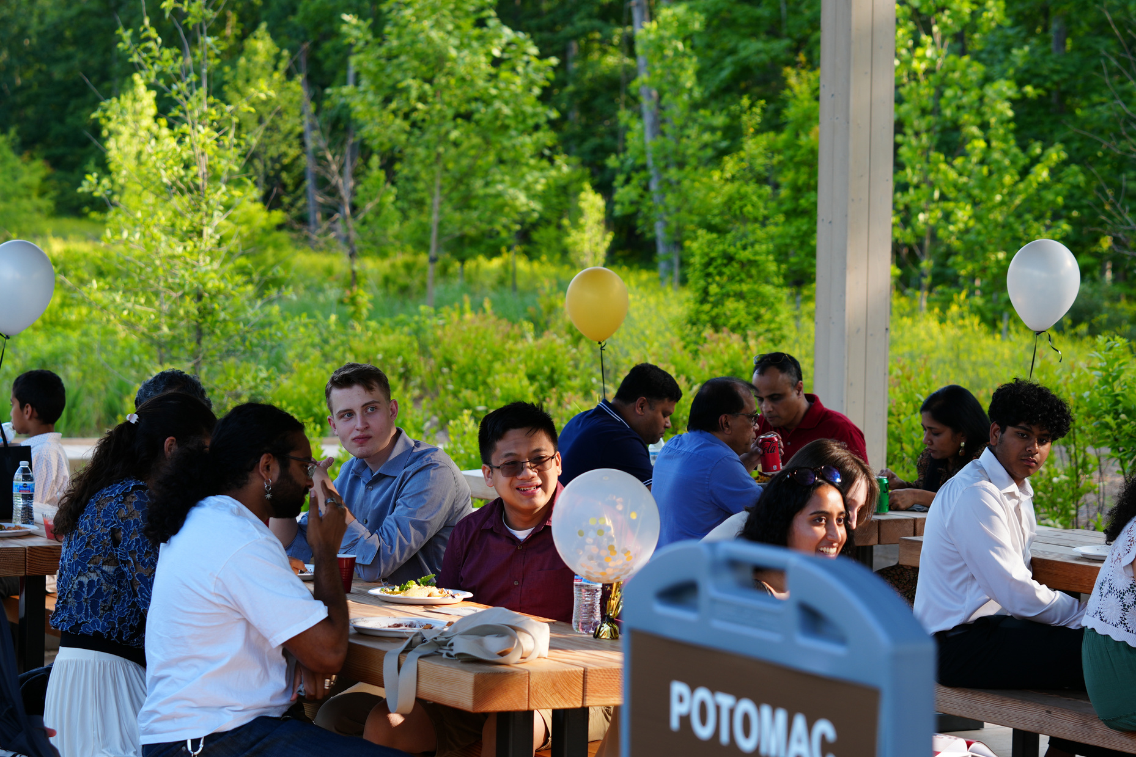
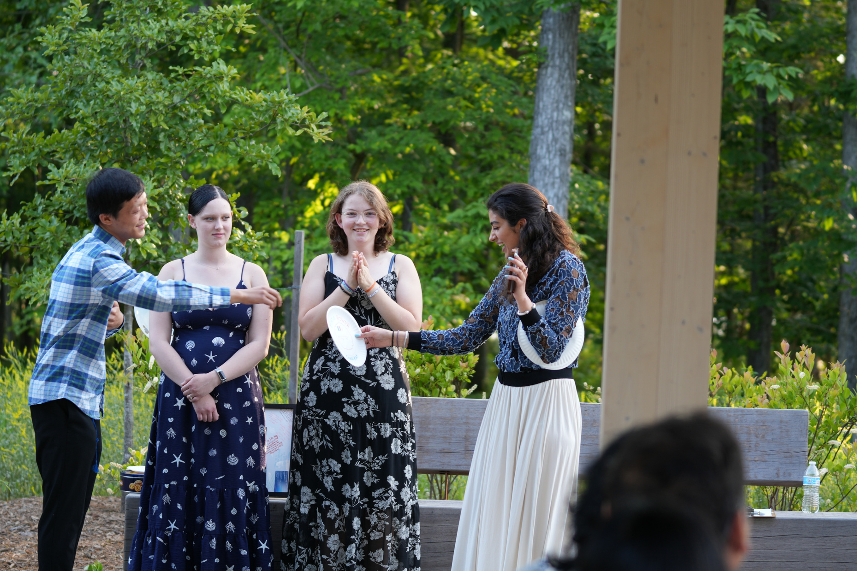
2024 Banquet

Slide 16
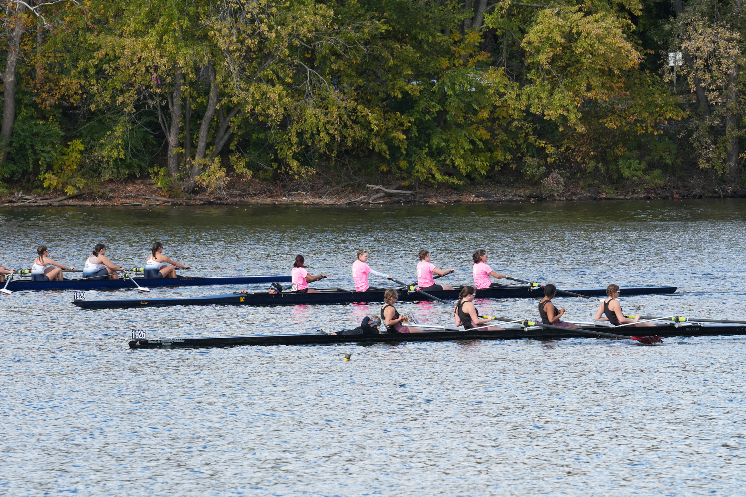
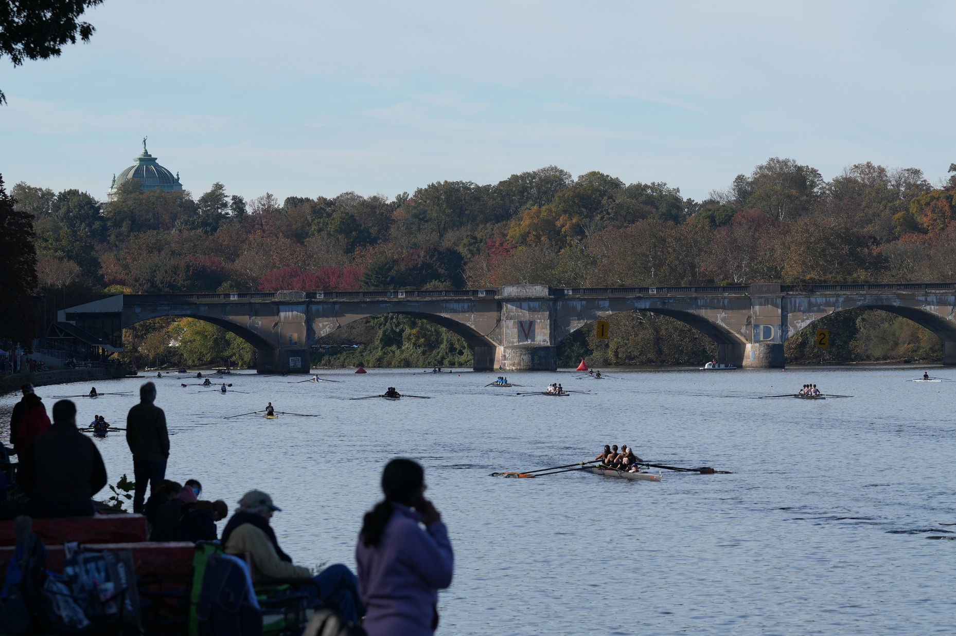
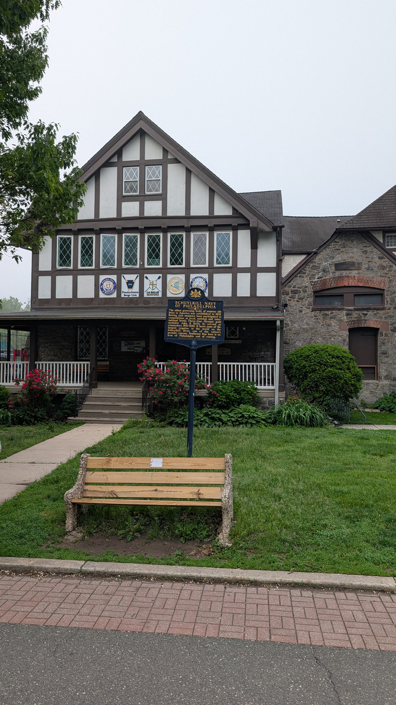
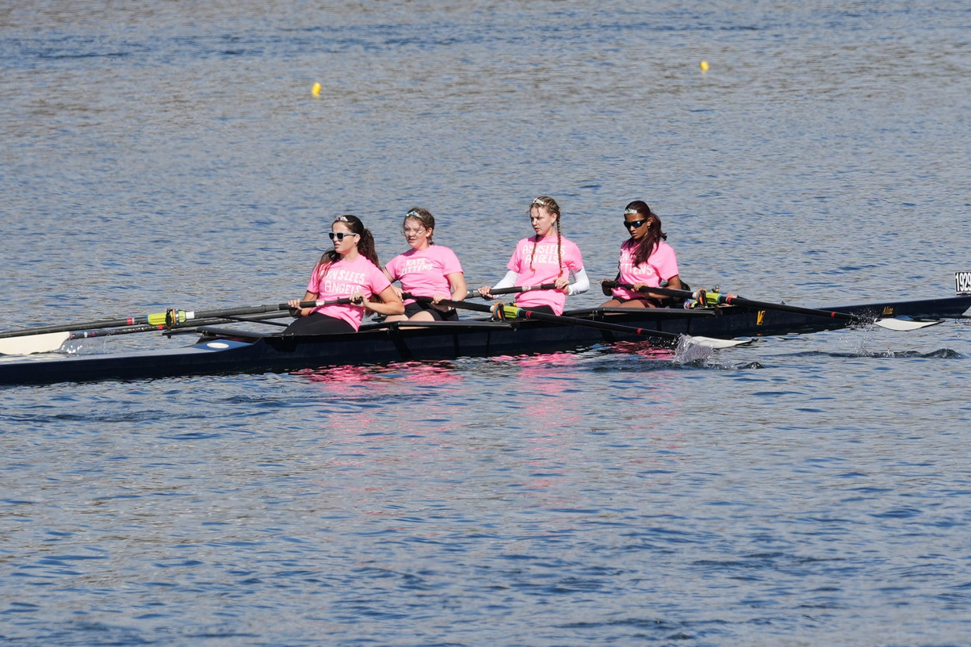
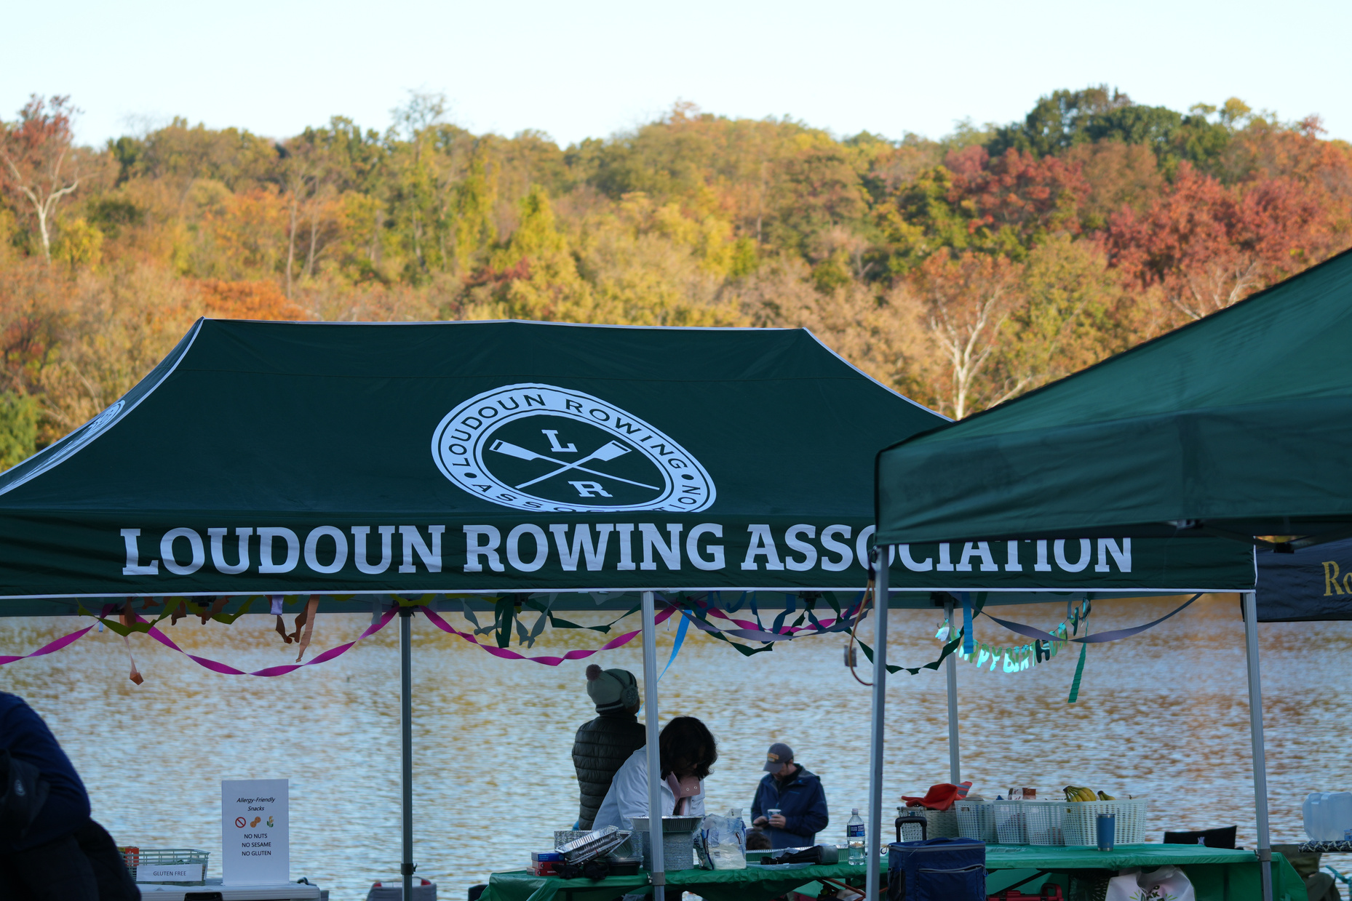

Slide 17
Questions?

Slide 18
Thank you!

